Slide 1
Intro To Mobile Application
DARREN Murray T00163856

Slide 2
Definition of frameworks
The definition of framework is a set of functions you can get used that are orgainised into classes.
What is it’s purpose?
The purpose is to allow a developer to do more functions with less code through a process called chaining.
Most framework’s have plugins which are pre coded functions that you can manipulate, they are very useful and can save a lot of time.

Slide 3
Features of Using jQuery
The framework I chose is jQuery
There is a lot of features using jQuery such as the amount of plugins.
There is a useful method called .delay() method allows us to delay the execution of functions that follow it in the queue. It can be used with the standard effects queue or with a custom queue.
You can also control the amount of time user or users can view images or text.

Slide 4
Limitations using jQuery
The limitations using jQuery optional arguments are not very well supported.
It wont have the feature or looks of native apps but will run on both mobile platforms iOS and Android.
It is slower then native apps.
Like nearly all frameworks doesn’t have all the features that none web pages have.
If your smart phone is running slow then using these non- native apps would be very slow on you phone.

Slide 5
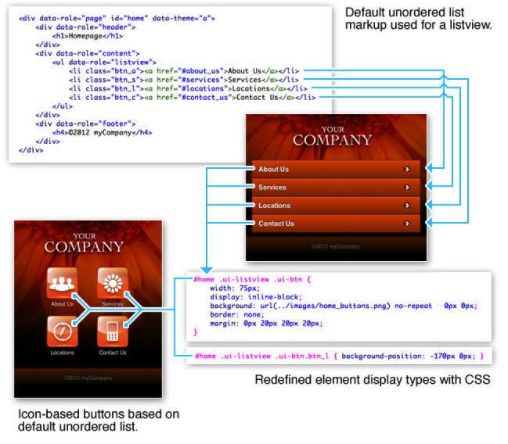
Examples of Usage
Here is an image of how to code icons:

Slide 6
Examples of Usage
That basically shows how to link up the buttons on a very helpful guide using jQuery.
It is shows how to make the web app stylish.
The most impressive plugin you can use for jQuery is Google maps.

Slide 7
Identify other existing frameworks
The other existing frameworks I know about are:
Prototype
MooTools
YUI or Yahoo! User Interface Framework
Ext JS
script.aculo.us
Titanium Mobile
Mobilize.js
DHTMLX Touch
Jo

Slide 8
Reasons Behind Choosing jQuery
jQuery was the only framework I personally used before on www.codeacademy.com which teaches you everything from HTML to PHP, so I had prior knowledge of jQuery
A lot of top internet websites use jQuery such as Google and Netflex, so I knew from that as well it would be a good framework to chose.
It is one of the most popular framework out there with the most support and advice/tutorials.
It also had excellent plugins which contributed a lot in my decision .

